Slide 1

Before we begin
Coffee?

Slide 2

Special Input Output (IOT)
Changing online variables with Node MCU, ajax and JSON
COLOR MATCHING APPLICATION
Mike Raadsheer
2556 - GD2B

Slide 3
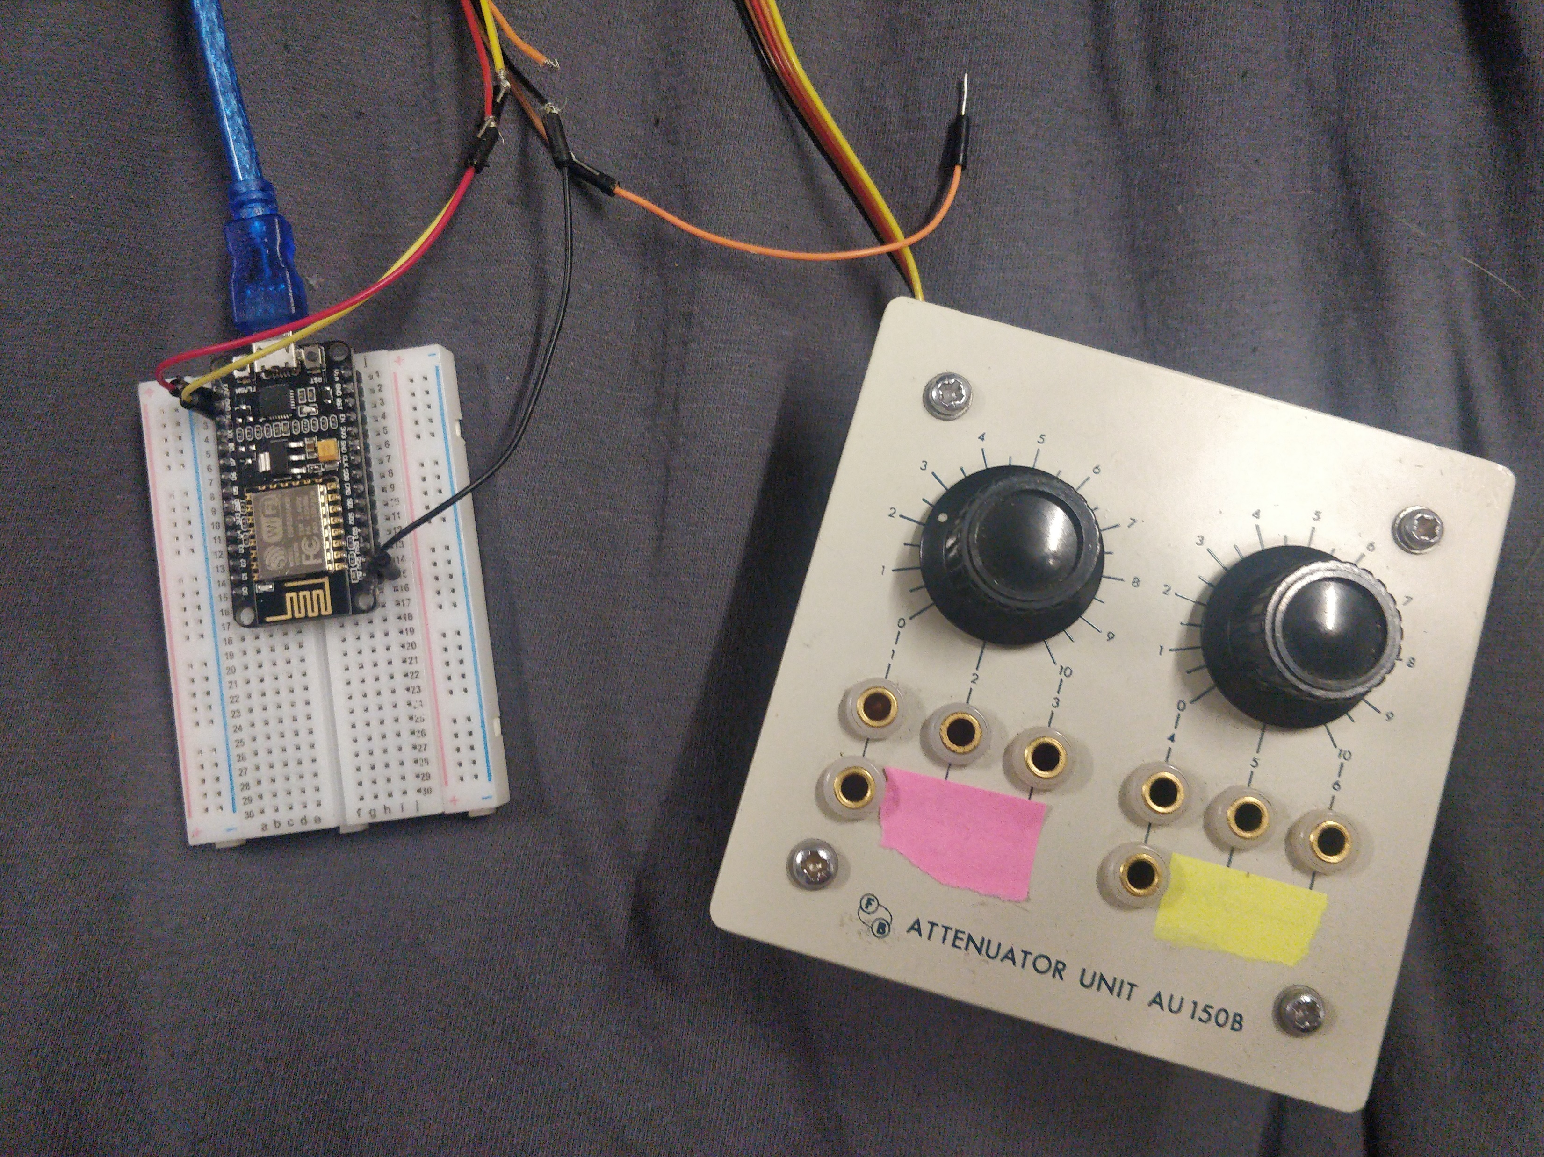

What we’ll cover today
Hardware
Software
Design
Tests

Slide 4
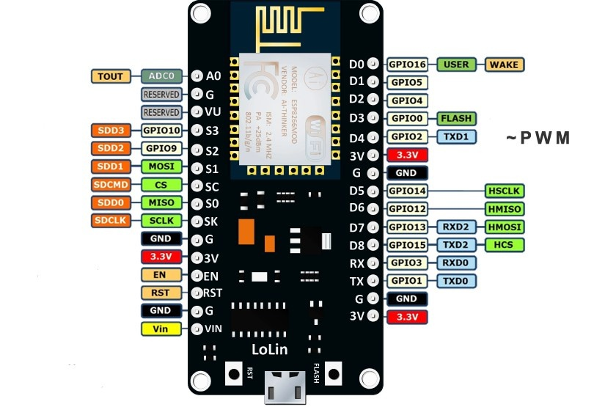
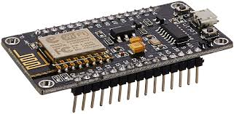
Hardware
Input – Arduino (Node MCU) / online forms

Slide 5
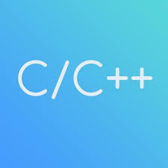





Software
Node MCU (Arduino library)
HTML, JS, AJAX, PHP, CSS

Slide 6
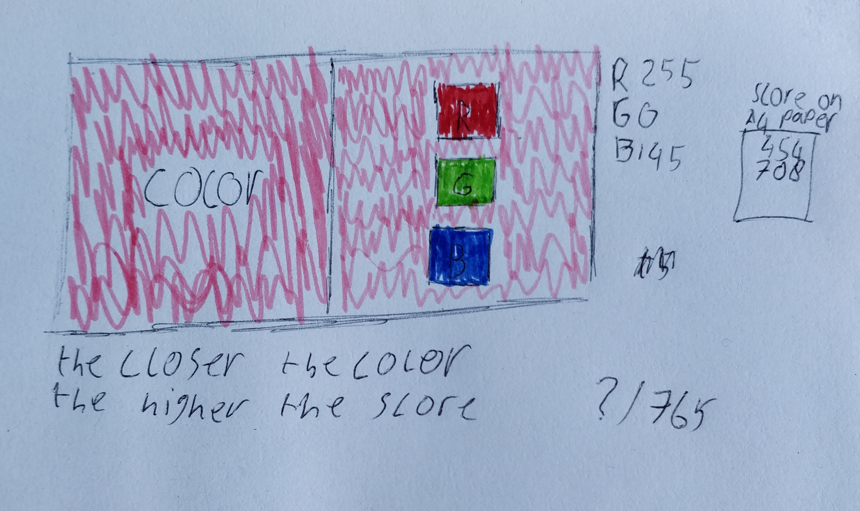
Design
Product
Reason
Target Group

Slide 7
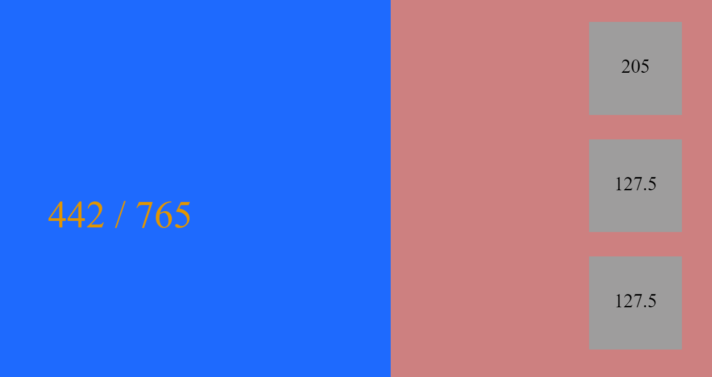
Tests
Server side requests (ajax)
Arduino converting a voltage to a float
Node MCU
Set a color to X ammount
Application
Color reloader

Slide 8
Questions?

